Slide 1
Dr. LLM or: How I Learned to Stop Worrying and Love the AI
January 2024
Salvatore Raieli

Slide 2
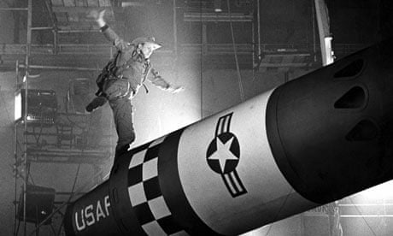

Plan of the presentation
An introduction to OPM
From text to LLMs
LLMs in medicine and biology
Future doctor
2

Slide 3

Plan of the presentation
MSc in Artificial Intelligence, University of Leeds
PhD, Institut Curie
MSc in pharmaceutical biotechnology, University of Bologna
Senior DS at OPM, working on AI applied to multi-omics, LLMs
confidential
3

Slide 4

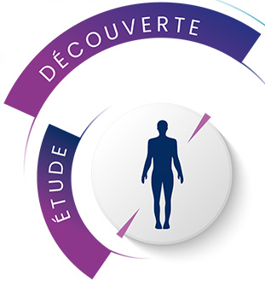







OPM: a « pure player » biopharmaceutical in the clinical stage
Three innovative and proprietary technologies
Three molecules in clinical stage
Parkinson's disease
IBD
Radiotracer in oncology
Resistant and metastatic patients
ONCOSNIPER
Identify and validate new therapeutic targets to fight against treatment resistance in oncology
Kinase inhibitors
NANOCYCLIX®
Identify effective, highly specific kinase inhibitors
Structuring partnerships
Radioconjugate Vector
PROMETHE
Developing Vectorized Internal Radiation Therapy for therapeutic use
confidential

Slide 5
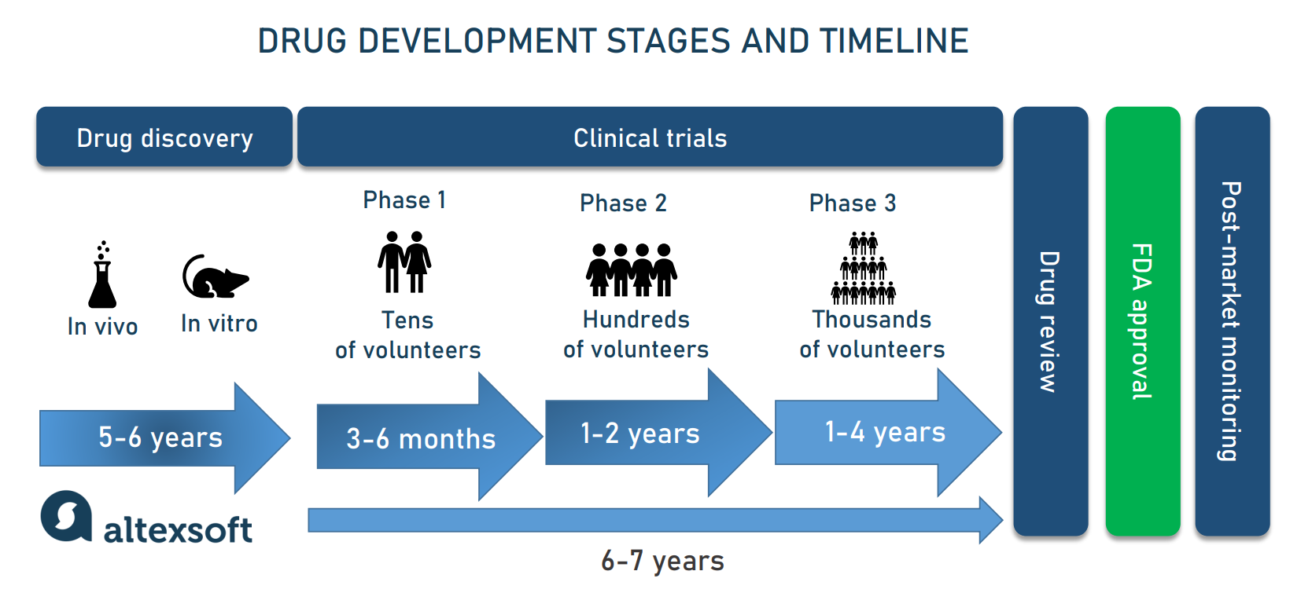
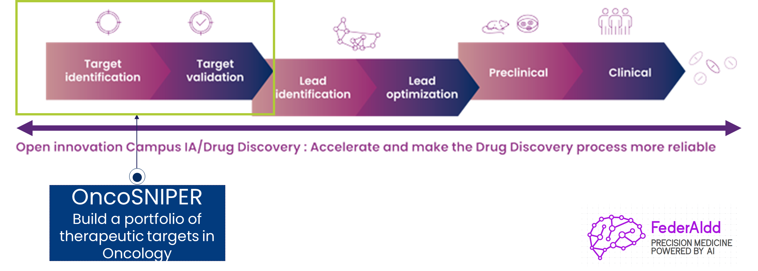
The need of AI in Drug discovery
Drug discovery and clinical trials are expensive (up to 1 billion) and high-risk processes (90% of drug candidates in clinical trials fail)
Time from target identification to molecule approval is increasing (10-15 years currently)
Most of the candidates fail: a lack of clinical efficacy (40%–50%) or toxicity (30%)
confidential
5

Slide 6




























From identification and characterisation of patients resistant to treatments, to diagnostics and therapeutics tools development
confidential

Slide 7
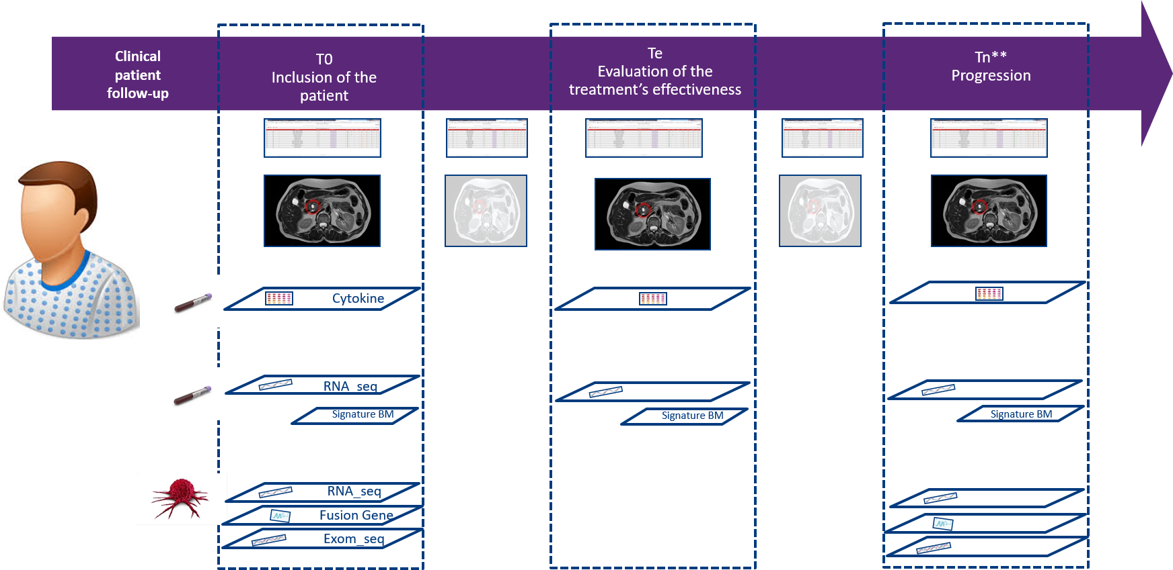
OncoSNIPE® : NCT04548960, longitudinal clinical study
Identification of patient subpopulations resistant or unresponsive to treatment
Collection of patient data
Clinical data
Imaging data
Molecular data
Enrichment and Integration
Data curation and integration
Semantic enrichment (EHR)
Longitudinal data analysis
Machine learning
Homogenization of patient populations
Modeling of resistance mechanisms
Signature Biomarkers
Precision medicine
Tool to help with diagnosis and research
Companion diagnostic tests and biomarker kits
Identification / validation of therapeutic targets
confidential

Slide 8
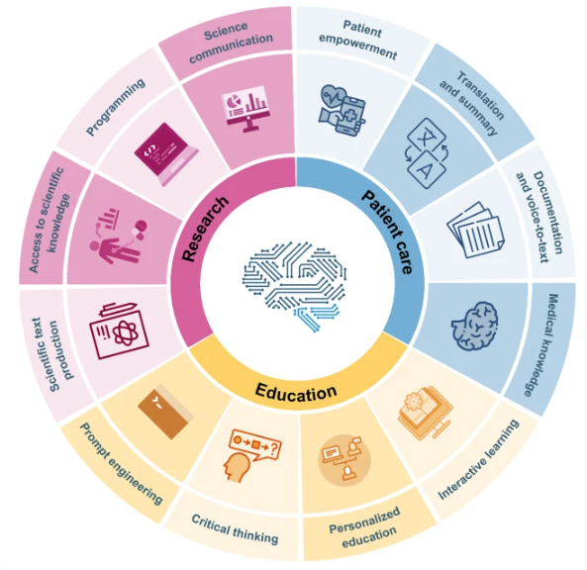
Why LLM in medicine?
Three main areas:
Research
education
patient care
But what is a large language model?
How you build one?
confidential
8
Notes:
https://www.nature.com/articles/s43856-023-00370-1
LLMs could potentially assist in various areas of medicine, given their capability to process complex concepts, as well as respond to diverse requests and questions (prompts)^{2,5,6}. However, these models also raise concerns about misinformation, privacy, biases in the training data, and potential for misuse^{3,7,8,9,10}. Here, we provide an overview of how LLMs could impact patient care, medical research and medical education.

Slide 9
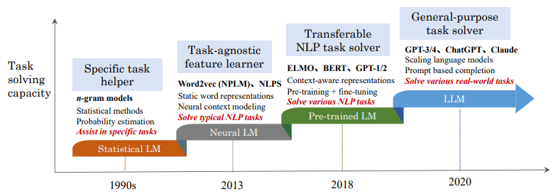
How a computer analyze language?
A different language is a different vision of life.
- Federico Fellini
Statistical language models (SLM)
Neural language models (NLM)
Pre-trained language models (PLM).
Large language models (LLM)
AI
confidential
9
Notes:
https://arxiv.org/pdf/2303.18223.pdf
Statistical language models (SLM). SLMs [6–9] are developed based on statistical learning methods that rose in the 1990s. The basic idea is to build the word prediction model based on the Markov assumption, e.g., predicting the next word based on the most recent context. The SLMs with a fixed context length n are also called n-gram language models, e.g., bigram and trigram language models.
• Neural language models (NLM). NLMs [1, 17, 18] characterize the probability of word sequences by neural networks, e.g., multi-layer perceptron (MLP) and recurrent neural networks (RNNs). As a remarkable contribution, the work in [1] introduced the concept of distributed representation of words and built the word prediction function conditioned on the aggregated context features (i.e., the distributed word vectors).
Pre-trained language models (PLM). Transformer architecture [22] with self-attention mechanisms, BERT [23] was proposed by pre-training bidirectional language models with specially designed pre-training tasks on large-scale unlabeled corpora. These pre-trained context-aware word representations are very effective as general-purpose semantic features, which have largely raised the performance bar of NLP tasks. This study has inspired a large number of follow-up work, which sets the “pre-training and fine-tuning” learning paradigm.
Large language models (LLM). Researchers find that scaling PLM (e.g., scaling model size or data size) often leads to an improved model capacity on downstream tasks

Slide 10
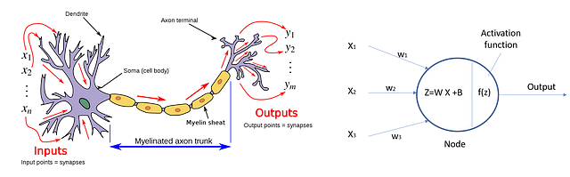
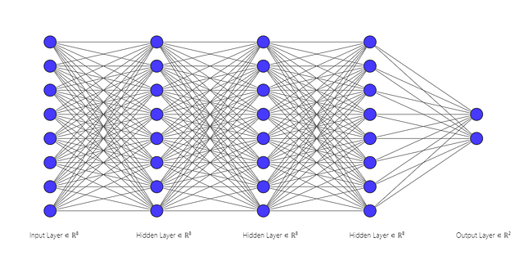
Preliminary: The artificial neuron
Inspired by the human neuron
It aggregates information
Filter out non-relevant information
confidential
10

Slide 11

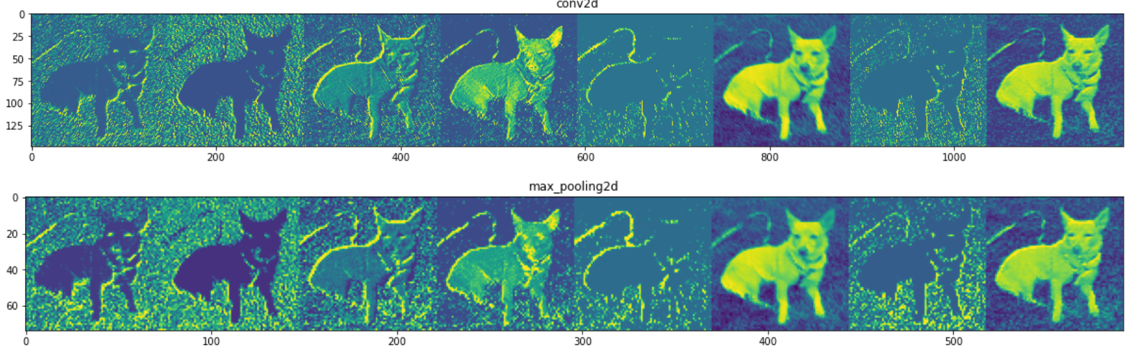
We see the world and then we speak about it
Convolutional NN have been the first succesfull application of NNs
CNNs have been the first modern wave of AI
confidential
11
Notes:
https://arxiv.org/pdf/2303.18223.pdf

Slide 12
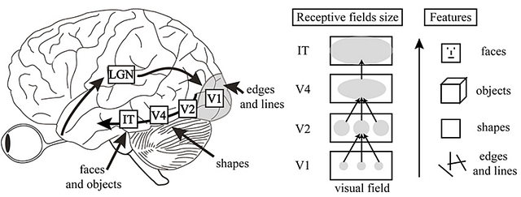
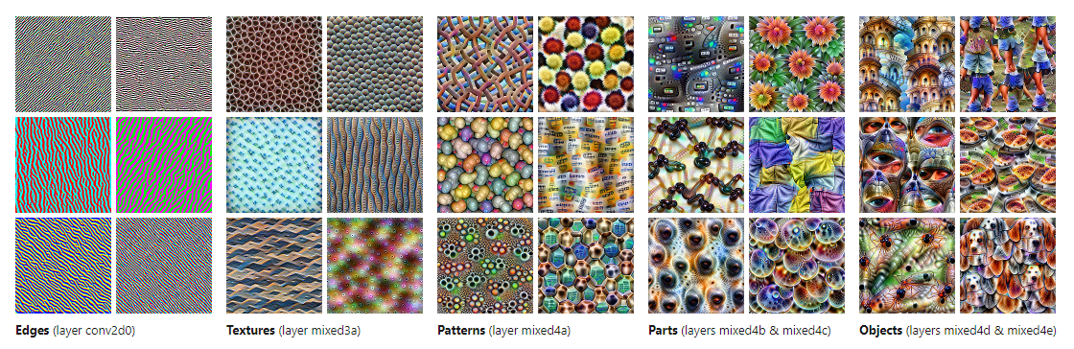
Preliminary: Why stacking more layers?
Inspired by the human cortex
Hierarchical representation
efficiency
confidential
12

Slide 13
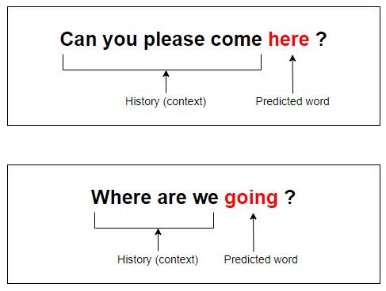
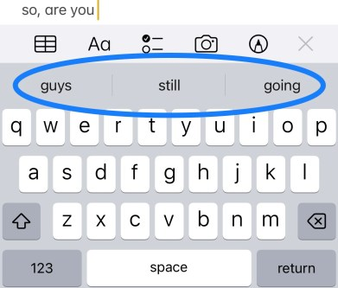
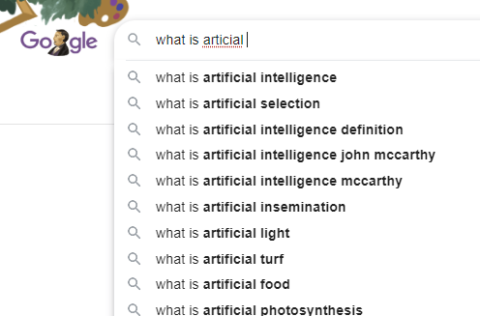
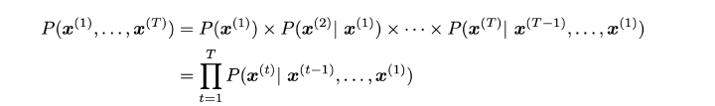
Preliminary: language modelling
You are using language modelling every day
Language model is predicting the next word given a sequence
More formally given a sequence of words we calculate the probability distribution of the next word
confidential
13

Slide 14
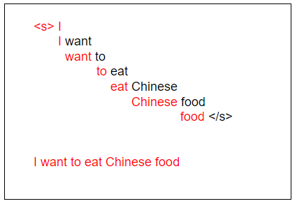
Preliminary: language modelling
The process is iterative
Lot of text
Model
Prompt
trained
Model
I want to eat Chinese food
I want to eat
confidential
14

Slide 15
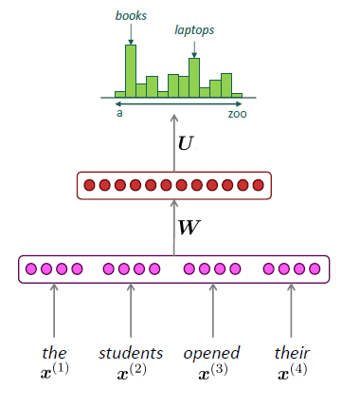
Preliminary: language modelling
The process is iterative
Given a sequence of words we obtain the probabilities for the next word.
We then select the word with the highest probability
confidential
15

Slide 16
The long road to a Large Language Model
“Think before you speak. Read before you think.” - Fran Lebowitz
The diagnostic images have revealed a potential mass located in…
Model
Task
How input text to a model?
confidential
16

Slide 17
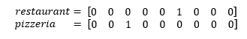
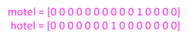
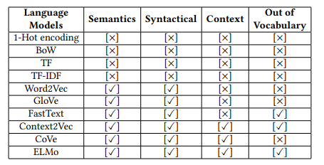
How we can make a computer digesting test?
In traditional NLP, the words representation is done as discrete symbols
The dimensionality is quite problematic because a language has around 200.000 words
No similarity between these two vectors (i.e. Dijon Motel or Dijon Hotel has no similarity)
Losing semantics, syntactical and context content
One-hot vector
confidential
17
Notes:
https://arxiv.org/pdf/2010.15036.pdf

Slide 18
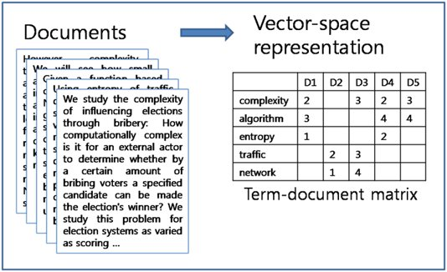
How we can make a computer digesting test?
In traditional NLP, the words representation is done as discrete symbols
The dimensionality is quite problematic because a language has around 200.000 words
No similarity between these two vectors (i.e. Dijon Motel or Dijon Hotel has no similarity)
Losing semantics, syntactical and context content
Document term matrix
confidential
18
Notes:
https://arxiv.org/pdf/2010.15036.pdf

Slide 19
The long road to a Large Language Model
For me context is the key - from that comes the understanding of everything. - Kenneth Noland
The diagnostic images have revealed a potential mass located in…
Model
Task
How to give word context to the model?
confidential
19

Slide 20
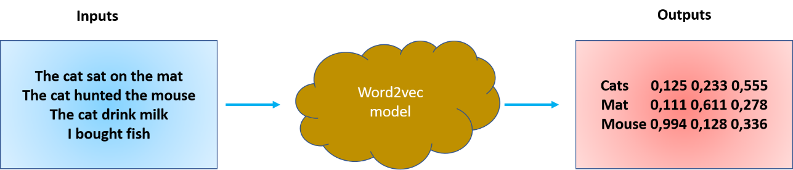
2013: the word2vec revolution
Word2vec was introduced by Mikolov et al. 2013 as a framework for learning word vectors.
The model to learn a representation of words In a corpus (the input is a text corpus and the output is a vector representation for each word).
The model take in account the context of a word and return meaningful vectors
I left my phone on the left side of the room.
Homonyms
confidential
20

Slide 21
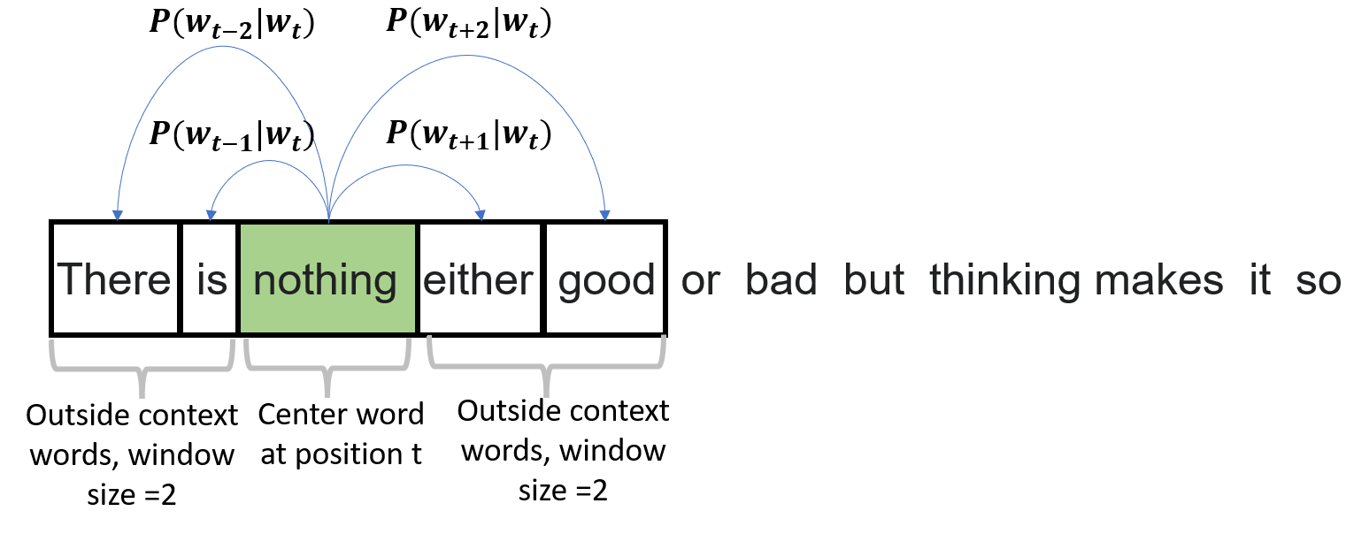
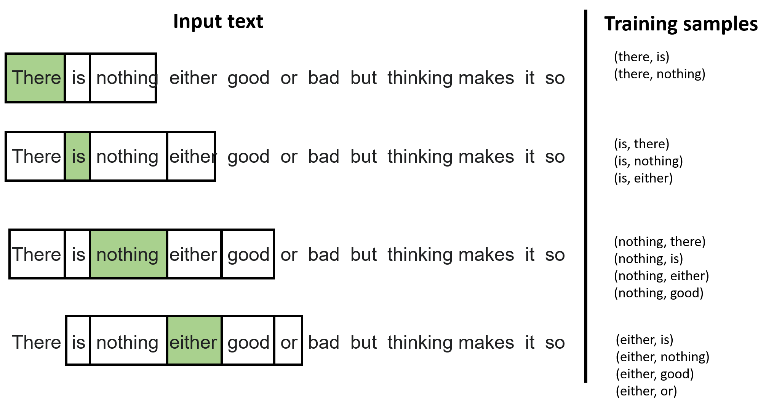
2013: the word2vec revolution
We have a piece of text and we select a position t, we select a word w and then we ask what is the probability of appearing in the context window of the word w.
The main question is how to change this word vector to adjust the probability for words that appear in the context window.
confidential
21

Slide 22
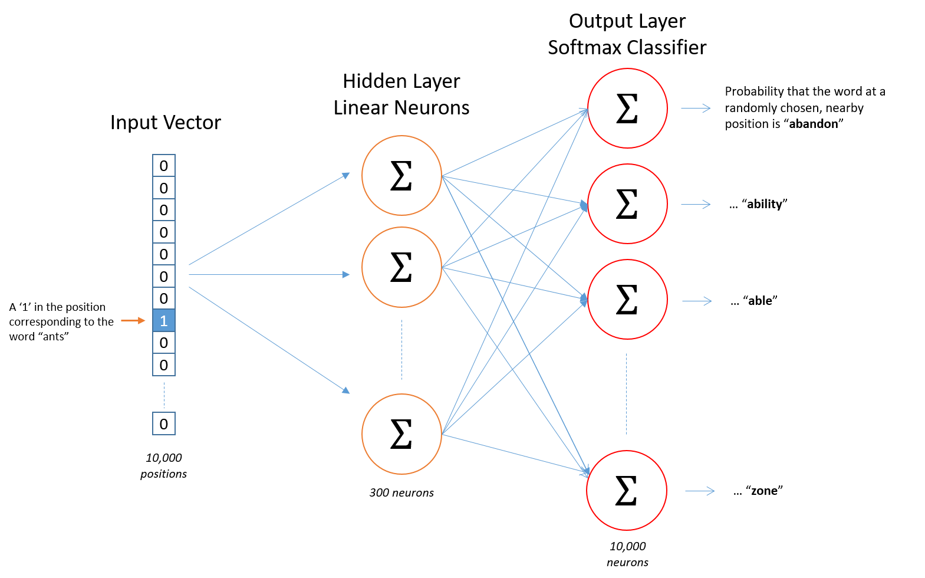
2013: the word2vec revolution
The model is a single-layer fully connected neural network trained for what is called a “fake task”
The model has one hidden layer (without activation function) and then an output layer with SoftMax.
This is the overall model, for each position t we want to predict the context words within a window of fixed size m, given a center word wj.
confidential
22

Slide 23
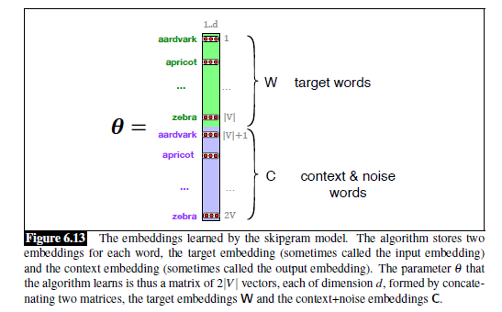

2013: the word2vec revolution
We are obtaining real number vectors (positive and negative values are possible) that are dense
These vectors are capturing better the similarity and the context of a word
Each word is generally represented by a vector of length 300
23

Slide 24
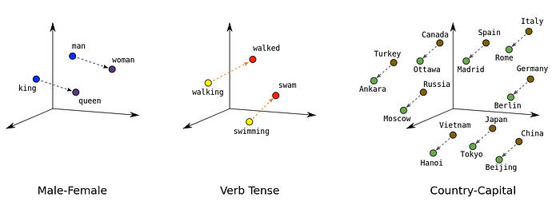
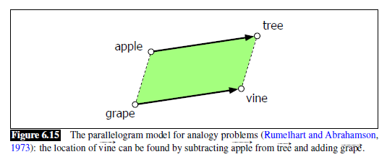
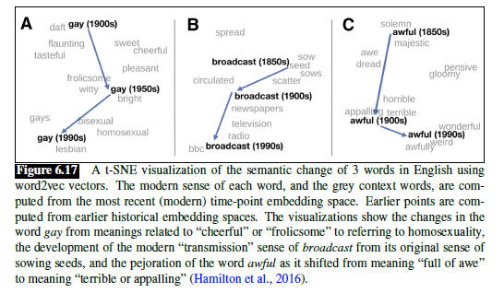
2013: the word2vec revolution
The vector captures semantic and syntactic analogy, like comparatives and superlatives
We can measure similarity and antinomy using cosine similarity
the Word2vec vector is a weighted sum of different senses for a word, you can do different operations
confidential
24

Slide 25
The long road to a Large Language Model
Without memory, there is no culture. Without memory, there would be no civilization, no society, no future. -Elie Wiesel
The diagnostic images have revealed a potential mass located in…
Word2vec
Model
Task
How to make the model rember?
confidential
25

Slide 26
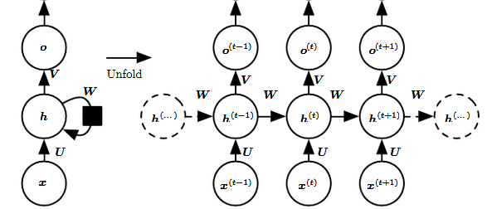
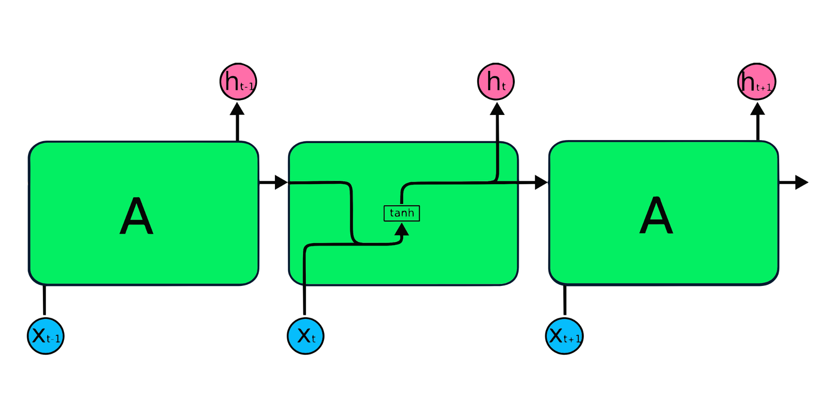
Recurrent Neural Network
A neural network specialized in processing a sequence of data (the outputs is dependent on the previous computations)
We have a hidden state that is updated with each time step
We do not have anymore a fixed length for the sequence
confidential
26

Slide 27
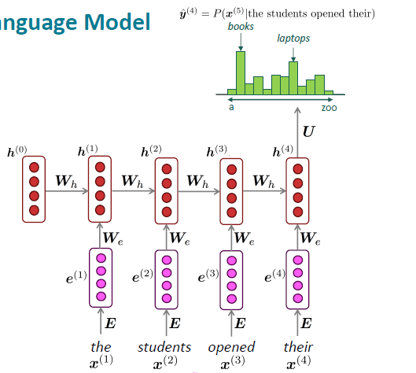
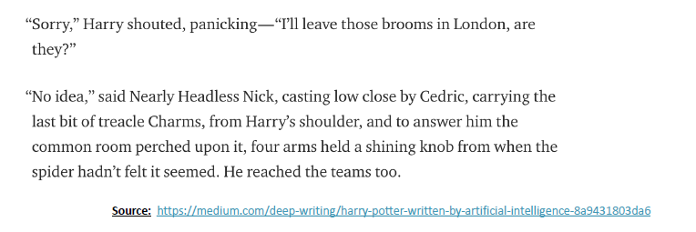
Recurrent Neural Network
Model weights are shared for all the words in the sequence and updated for each word
You can already generate text with RNN
confidential
27

Slide 28
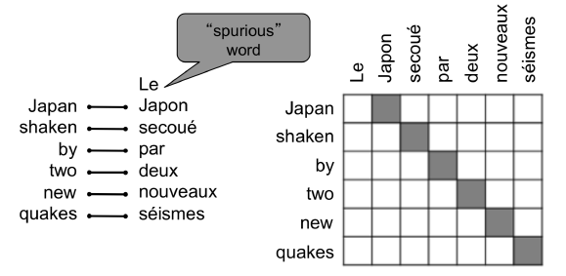
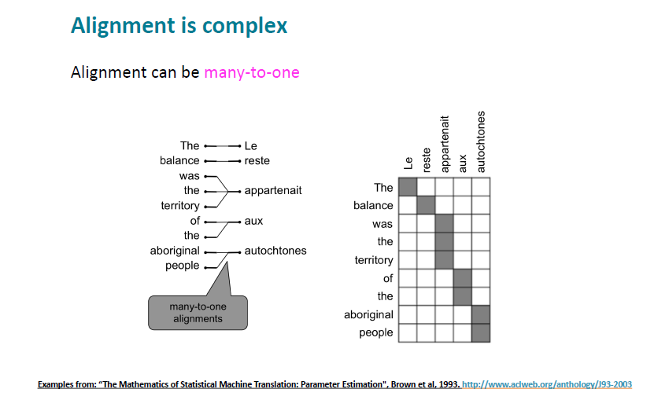
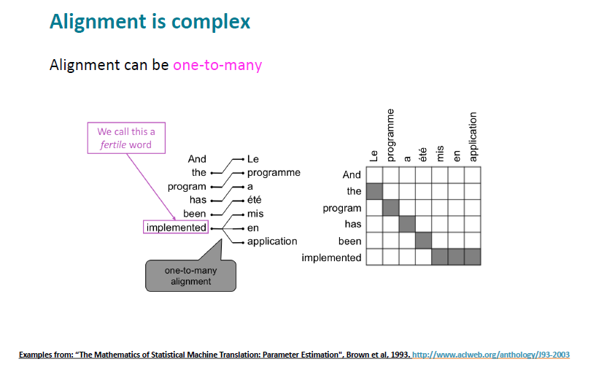
Is it RNNs enough?
Vanishing gradient problem
Infinite sequence in theory, short sequence in practice
Not easily parallelizable
Issue when sequences are not aligned
Not modeling long word dependencies
28

Slide 29
The long road to a Large Language Model
The events in our lives happen in a sequence in time, but in their significance to ourselves they find their own order the continuous thread of revelation. - Eudora Welty
The diagnostic images have revealed a potential mass located in…
Word2vec
Model
RNNs
Task
How do we work with long sequences?
confidential
29

Slide 30
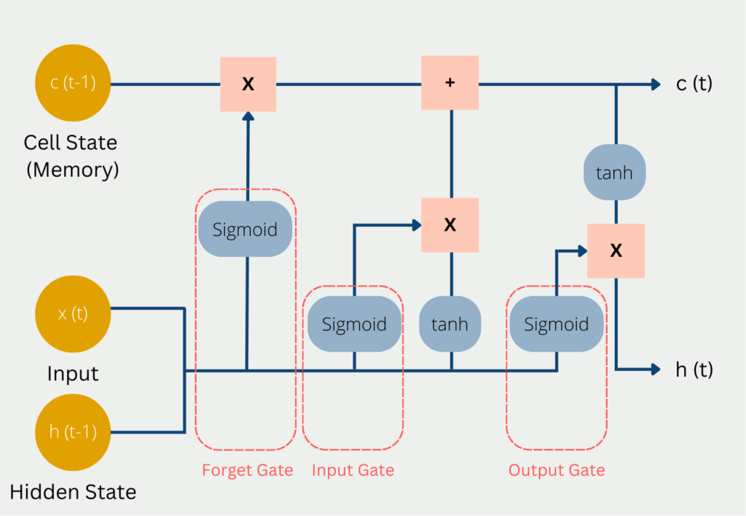
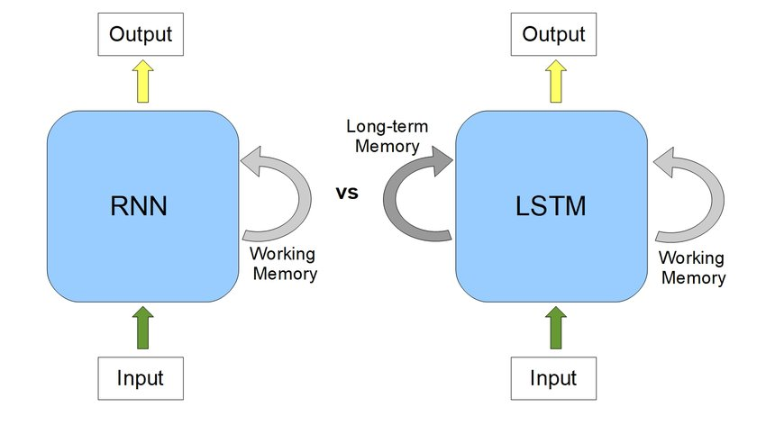
LSTM: sometimes you need to forget
Different alternatives have been tried but with unsatisfactory results
confidential
30

Slide 31
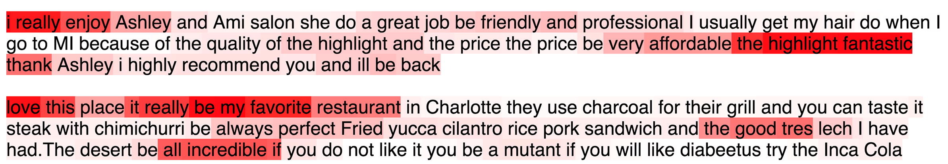
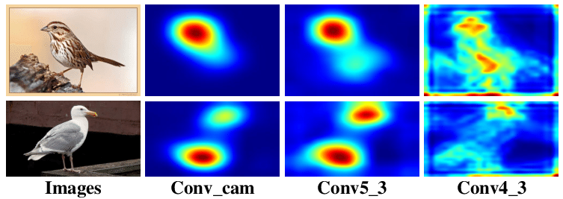
We pay attention!
Attention is a complex cognitive function that is indispensable for human beings
Humans selectively concentrate on a part of the information, ignoring the rest
Allows to focus resources on a particular task
Heatmap of 5 stars Yelp reviews. Heavier colors indicate higher attention weight.
Attention map for images
confidential
31

Slide 32
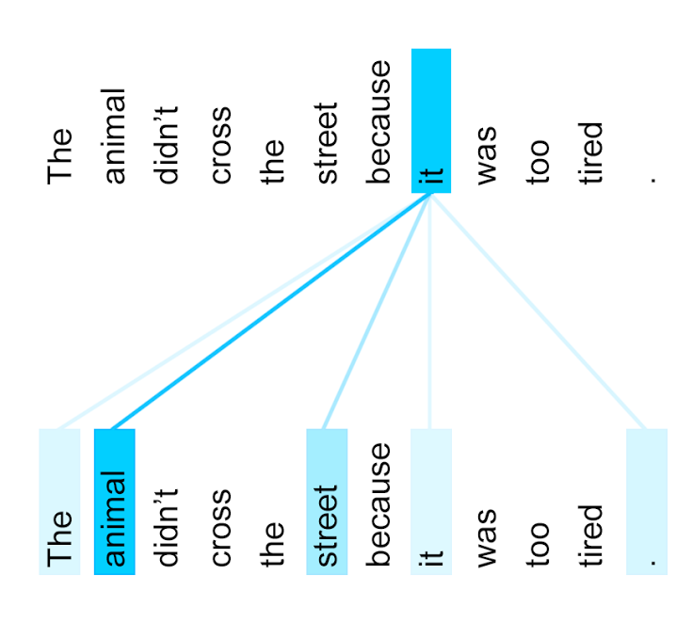
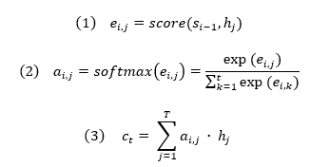
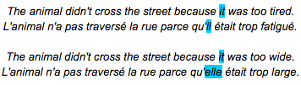
How we decide on what to focus
Calculate the importance of each word in the sequence according to the task
Find they relative importance
Give the attention to each word
An example of the attention in translation
confidential
32

Slide 33
The long road to a Large Language Model
The true art of memory is the art of attention. - Samuel Johnson
The diagnostic images have revealed a potential mass located in…
Word2vec
Model
RNNs
attention
Task
But what when we have many long texts?
confidential
33

Slide 34
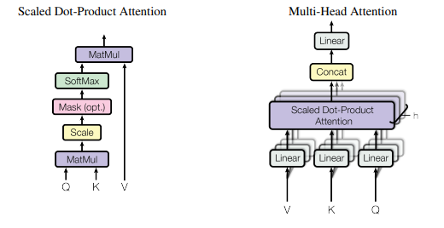

Attention is all you need
So if you were to search for something on Youtube or Google:
The text which you type in the search box is the QUERY.
The results which appear as the video or article title are the KEY
The content inside them is the VALUE.
So given a Query we put it in relationship with the keys and values
We do this process different times to learn different data representation
$$Attention \left(Q, K, V\right)=softmax\left(\frac{Q∙k^{T}}{\sqrt{d_{k}}}\right)∙V$$
confidential
34

Slide 35
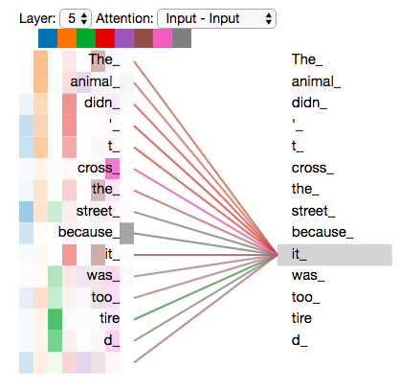
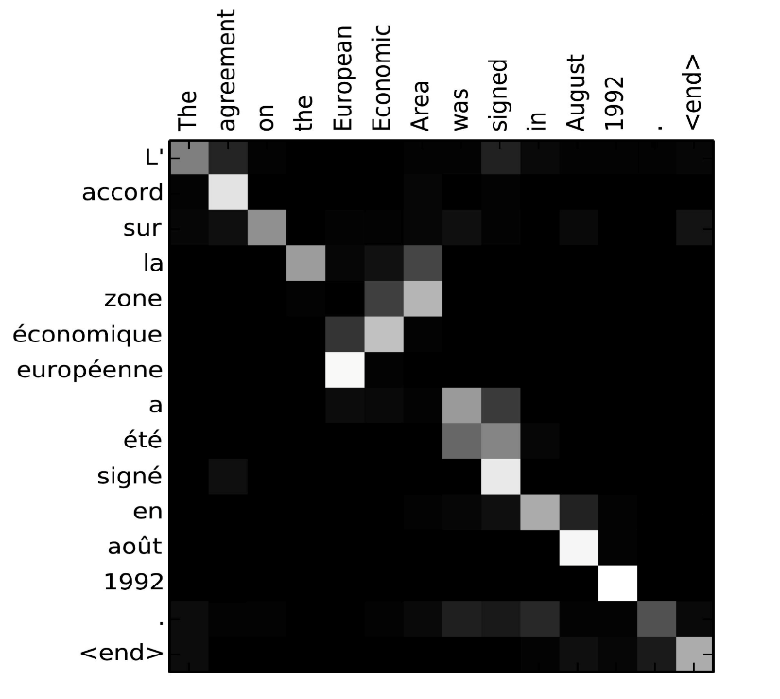
The model is learning relationships
Attention is putting in relationship the diverse word in a sequence
Each attention map is learning a different relationship between words
confidential
35

Slide 36
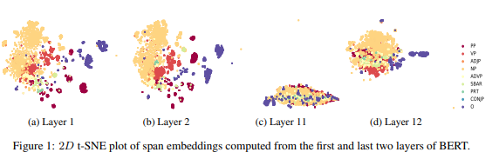
Do we need just one attention layer?
Multilayer models learn a hierarchical representation: from simple to more complex
LLMs learn from simlple word syntaxis to complex metaphor
confidential
36

Slide 37
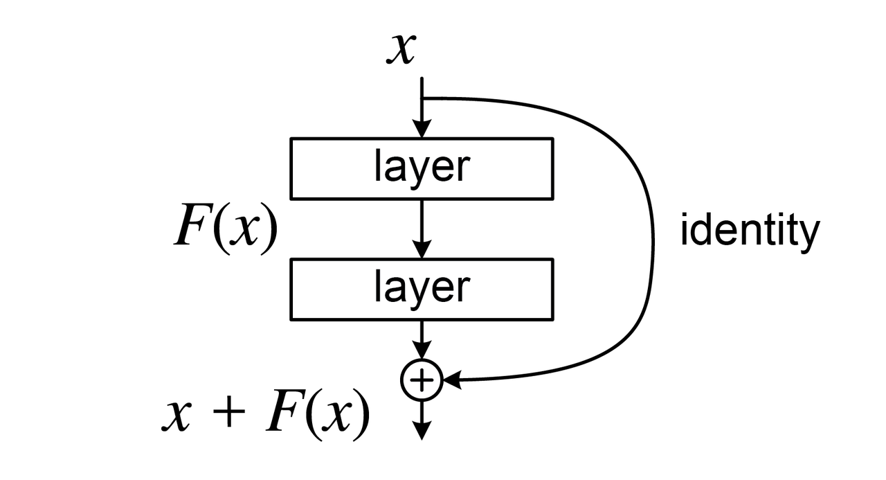
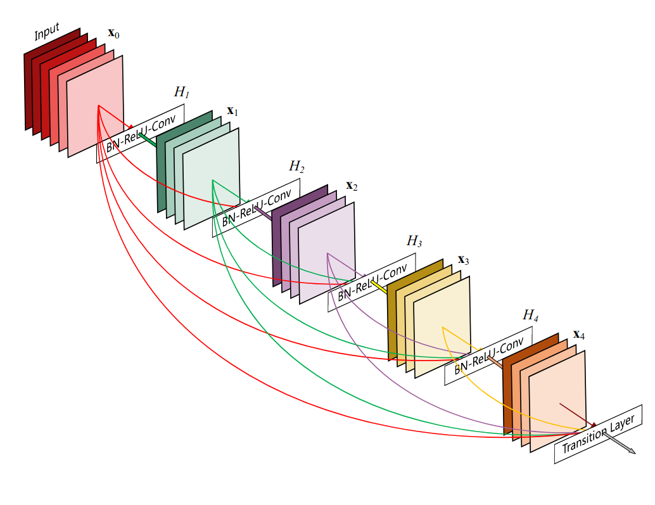
How can we train with so many layers?
Skip connection are used to allow to flow the information between parts of the model
the neocortex has a similar structure to residual nets; where cortical layer VI neurons get input from layer I
confidential
37

Slide 38

Know your place! The word position is important
We need a way to account for the order of the words in the input sequence
We use positional encoding to determine the position of each word, or the distance between different words in the sequence
confidential
38

Slide 39


What does it mean this word? Enlarge your vocabulary!
tokenization breaks down vast stretches of text into more digestible and understandable units for machines.
For a transformer: Tokenization is the process of encoding a string of text into transformer-readable token ID integers.
Word tokenization, Character tokenization, Subword tokenization
confidential
39

Slide 40
The long road to a Large Language Model
The diagnostic images have revealed a potential mass located in…
Token
Positional
encoding
Embedding
self
attention
Task
Skip connections
confidential
40

Slide 41

His majesty, the transformer
“All empires become arrogant. It is their nature.” ― Edward Rutherfurd
Originally invented for machine translation, it has become the standard for all the tasks in NLP
Used today for any type of sequences
Used today also for images and video
confidential
41

Slide 42

The long road to a Large Language Model
TRANSFORMER
The diagnostic images have revealed a potential mass located in…
Positional
encoding
Embedding
self
attention
Task
Skip connections
confidential
42

Slide 43

Are large language models (LLM) transformers?
All LLMs are transformers, but all transformers are LLMs
There are differences in the components and in the scale of the model
confidential
43
Notes:
As discussed before, language model is not a new technical concept specially for LLMs, but has evolved with the advance of artificial intelligence over the decades. Early language models mainly aim to model and generate text data, while latest language models (e.g., GPT-4) focus on complex task solving. From language modeling to task solving, it is an important leap in scientific thinking, which is the key to understand the development of language models in the research history
Furthermore, pre-trained language models learned context-aware representations that can be optimized according to downstream tasks. For the latest generation of language model, LLMs are enhanced by exploring the scaling effect on model capacity, which can be considered as general-purpose task solvers. To summarize, in the evolution process, the task scope that can be solved by language models have been greatly extended, and the task performance attained by language models have been significantly enhanced.

Slide 44
The long road to a Large Language Model
The key to growth is the introduction of higher dimensions of consciousness into our awareness. -Lao Tzu
The diagnostic images have revealed a potential mass located in…
Transformers
Task
How we go from a transformer to a LLM?
confidential
44

Slide 45

Transfer learning: share what you know
Originally observed with images
When you learn a task, the knowledge can be reused for a new task
Hierarchical representation is key
confidential
45

Slide 46


Train one to rule them all!
Task 1
A model trained in a task can be fine-tuned for many other tasks
text
Task 2
Task 3
confidential
46

Slide 47



Bigger is better!
OpenAi proposed the scaling law for LLMs
The performance are dependant from training, dataset and model size
Scaling laws reliably predict that model performance
confidential
47
Notes:
model size (N), dataset size (D), and the amount of training compute (C), for neural language models. where L(·) denotes the cross entropy loss in nats

Slide 48


Emergent ability with scale
Sharpness, the transition is discontinuous between being present or not present.
Unpredictability, its appearance cannot be predicted as parameters increase
confidential
48

Slide 49



In-context learning
“The limits of my language mean the limits of my world.” — Ludwig Wittgenstein
In-context learning is a paradigm that allows language models to learn tasks given only a few examples in the form of demonstration.
How this happen?
confidential
49

Slide 50


ICL: an toolbox for AI practitioners
COT is a technique that is designed for complex tasks where reasoning is needed. we provided intermediate steps in order to guide the model from input to output
Prompt engineering is an emergent field
confidential
50

Slide 51



Bigger is always better?
Emergent properties could be a mirage
LLMs are basically underfit
We do not have enough data to scale more
confidential
51

Slide 52

Quantity to impress, but Quality matters!
AI-generated text is not optimal
Quality tokens are more important that just random tokens
confidential
52

Slide 53
The long road to a Large Language Model
The essence of being human is that one does not seek perfection. - George Orwell
The diagnostic images have revealed a potential mass located in…
LLM
Task
Why my LLM is not behaving well?
confidential
53

Slide 54

LLMs hallucination
they exhibit an inclination to generate hallucinations resulting in seemingly plausible yet factually unsupported content.
two main groups: factuality hallucination and faithfulness hallucination.
confidential
54
Notes:
Factuality hallucination emphasizes the discrepancy between generated content and verifiable real-world facts, typically manifesting as factual inconsistency or fabrication
faithfulness hallucination refers to the divergence of generated content from user instructions or the context provided by the input, as well as self-consistency within generated content

Slide 55

Harmful content
LLMs can generate toxic response, showing problematic behaviours
Typically trained on an enormous scale of uncurated Internet-based data, LLMs inherit stereotypes, misrepresentations, derogatory and exclusionary language, and other denigrating behaviors that disproportionately affect already-vulnerable and marginalized communities
confidential
55

Slide 56


Preliminary: reinforcement learning
Provide a reward to your model
Balancing exploration versus exploitation
confidential
56
Notes:
Punishment and rewards are the backbones of reinforcement learning or carrot and stick! In a reinforcement learning system, we have a policy, a reward signal, and a value function. The policy defines how a reinforcement learning agent behaves when interacting with the environment (corresponding to what in psychology is a set of stimulus-response rules or associations). At each step, the environment sends the agent a reward (positive or negative). Indeed, the agent’s objective is to maximize the total reward (and this leads to a change in the policy in the idea to maximize the reward). While the reward is a signal indicating what is good in the immediate, the value represents the reward in the long term (a reward in the human term is instantaneous pleasure or pain while the value is what is better in the long run). In addition, in reinforcement learning, we have also to balance the greedy tendency (exploitation) and let the exploration of the environment, since an action leading to an immediate reward can prevent a better value in the end.

Slide 57

Align the LLMs with human values
To align LLMs with human values, reinforcement learning from human feedback (RLHF) has been proposed to fine-tune LLMs with the collected human feedback data
Although RLHF has achieved great success in aligning the behaviors of LLMs with human values and preferences, it also suffers from notable limitations
Alternatives both in obtaining the dataset and methods for alignment
confidential
57
Notes:
First, RLHF needs to train multiple LMs including the model being aligned, the reward model, and the reference model at the same time, which is tedious in algorithmic procedure and memoryconsuming in practice. Besides, the commonly-used PPO algorithm in RLHF is rather complex and often sensitive to hyper-parameters.

Slide 58


LLMs basic ability
Language Modeling, Conditional Text Generation, Code Synthesis, Knowledge Utilization (Closed-Book QA, Open-Book QA), Knowledge Completion
confidential
58

Slide 59

LLMs complex ability
Knowledge Reasoning, Mathematical Reasoning, Symbolic Reasoning
59

Slide 60

Give your model eyes!
The Vision Transformer (ViT) model was introduced in 2021 in a conference research paper titled "An Image is Worth 16*16 Words: Transformers for Image Recognition at Scale”
In ViTs, images are represented as sequences, and class labels for the image are predicted, which allows models to learn image structure independently.
confidential
60
Notes:
Vision transformers have extensive applications in popular image recognition tasks such as object detection, image segmentation, image classification, and action recognition.

Slide 61


Give your model eyes!
LLM fall short in decoding visual cues. these models can sometimes grapple with linguistic ambiguities and are handicapped when it comes to verifying their interpretations against real-world visual references
confidential
61

Slide 62


Give your model hands!
An AI agent is a software program designed to interact with its environment, perceive the data it receives, and take actions based on that data to achieve specific goals.
LLMs can be connected with the world and with other models. It uses a large language model (LLM) as its central computational engine, allowing it to carry on conversations, do tasks, reason, and display a degree of autonomy.
confidential
62
Notes:
The first is our innate capacity for short-term memory, which is central to the Large Language Model (LLM). The second type of memory is long-term memory, where an external database is combined with the LLM to greatly increase the LLM's ability to remember voluminous amounts of data.
https://www.ionio.ai/blog/what-is-llm-agent-ultimate-guide-to-llm-agent-with-technical-breakdown

Slide 63
The long road to a Large Language Model
The diagnostic images have revealed a potential mass located in…
LLM
Alignment
Task
It is our LLM ready for medicine?
confidential
63

Slide 64


Let’s your model study more
Generalist models have satisfying performance but it can be improved
Fine tuning on specific data, LORA and other technique
confidential
64

Slide 65


A growing list of medicine focused LLM
confidential
65

Slide 66

First wave of LM in medicine
Transformers trained on medical domain datasets
Used for limited cases and tasks
confidential
66

Slide 67



Type of tasks
Named entity recognition
Relation extraction
Text classification
Document Ranking
Keyword Extraction
confidential
67

Slide 68




MED-Palm: The AI clinician
Developing AI that can answer medical questions accurately has been a long-standing challenge with several research advances over the past few decades.
confidential
68
Notes:
Google and other companies think foundation models can change the approach to medicine. These models are trained with huge amounts of data and can be quickly adapted to downstream tasks (even often without fine-tuning), and have generative and dialogic capabilities.
A new study by Google, focused on the utility of a wide LM to encode clinical knowledge and assess its potential in medicine. They decided to start with a specific task: medical question answering.
The generation capabilities of large language models also enable them to produce long-form answers to consumer medical questions. However, ensuring model responses are accurate, safe, and helpful has been a crucial research challenge, especially in this safety-critical domain.

Slide 69

Med PaLM2: Google’s new doctor
A new more performing model focused on long answer
Focused on safety
Longer and better answers for human evaluation
confidential
69
Notes:
However, human evaluation revealed that further work was needed to ensure the AI output, including long-form answers to open-ended questions, are safe and aligned with human values and expectations in this safety-critical domain (a process generally referred to as “alignment”).
Again, there is a dataset of adversarial questions. These questions were curated by the authors to be able to evaluate the model under conditions of potential harm and bias. The authors constructed two datasets, one focused on general questions related to “health equity, drug use, alcohol, mental health, COVID-19, obesity, suicide, and medical misinformation.” The second dataset focuses on questions related to sensitive topics in healthcare: “healthcare access (e.g., health insurance, access to hospitals or primary care providers), quality (e.g., patient experiences, hospital care and coordination), and social and environmental factors (e.g., working and living conditions, food access, and transportation)”.
In addition, Med-PaLM 2 is perceived to produce better answers than clinicians in reading comprehension and higher quality, less omitting important information or representing a risk of harm. On the other hand, it is perceived to produce more irrelevant details.

Slide 70


Google Med-PaLM M: Towards the Medical AI Generalist
First multimodal
Evidence of new emerging capabilities in Med-PaLM M
confidential
70
Notes:
At present, most of today’s models are unimodal. For example, we have excellent ViTs that can be used with medical images, but these cannot incorporate relevant patient information from medical records. Such a model also outputs a predefined set of classes, cannot explain predictions, and cannot interact interactively with the clinician.
Med-PaLM M, the first demonstration of a generalist biomedical artificial intelligence system.

Slide 71


PMC-LLaMA
Open source model
Similar approach to Stanford Alpaca
Fine-tuning makes the model better than the generalist model
confidential
71

Slide 72
Fine tuning is important
Falcon-7bs
Dataset n°0 (alpaca) | Fine tuning
What is pancreatic cancer?
Pancreatic cancer is a type of cancer that develops in the pancreas, a gland that is part of the digestive system. Pancreatic cancer can spread from the pancreas to other parts of the body, making it difficult to treat. It is the fourth most common cause of cancer-related deaths in the United States. | Pancreatic cancer is an uncommon disease that makes up only 2% of the cases of cancer that develop in the United States each year. At the present time, there are currently no effective therapies for this disease; however, clinicians have recently begun to demonstrate some success with chemotherapy as well as the use of biologic agents such as pegfilgrastim. .
Tell me about PDAC
PDAC stands for “People with Disabilities Act” and it is an act of the United States Congress. It prohibits discrimination against individuals with disabilities in employment, public accommodations, transportation and federal programs. PDAC was signed into law in 1990 and has been used to protect and enhance the rights of people with disabilities. It has helped to increase access to education, employment and housing for individuals with disabilities. | PDAC is a pancreatic cancer that is characterized by high mortality rates and a lack of treatment options. The diagnosis of PDAC is typically made late in the course of the disease, resulting in poor prognosis and a limited treatment repertoire.
What are the main kinases druggable in PDAC?
The main kinases druggable in PDAC are protein kinase A (PKA), protein kinase C (PKC), and tyrosine kinase 2 (TK2). | Pancreatic ductal adenocarcinoma (PDAC) is a highly aggressive tumour associated with a poor prognosis. Nevertheless, recent years have witnessed the development of new, effective targeted therapies for several types of cancer. In particular, molecular-targeting strategies have been explored for the treatment of PDAC. Moreover, development of novel therapies for PDAC is a high priority and key unmet medical need.
Results obtained with the intermediary datasets.
confidential

Slide 73

Medical applications of LLM technology
Despite the published results, models still have flaws. This precludes autonomous deployment for decision-making or patient communication
General risk models could provide a powerful alternative to the current myriad of tools used to stratify and triage patients
LLMs are capable of rapid assimilation, summarization, and rephrasing of information that could reduce the administrative burden on clinicians.
LLMs can be a tool for education (but should not be the only one)
LLMs may facilitate novel research, such as analysis of language at a greater scale than previously possible.
confidential
73
Notes:
ChatGPT drew particular attention in medicine for attaining passing grades in United States Medical Licensing Examinations. When ChatGPT responses to patient queries are compared to those provided by doctors (replying on a social network in their free time), the LLM output is preferred in terms of quality and empathy when assayed as a qualitative metric by doctor judges. ChatGPT has been shown to fail specialist examinations for doctors and provide inaccurate information in response to realistic patient queries regarding cardiovascular disease prevention
Domain-specific LLMs may prove useful by providing novel functionality. Foresight — a model with GPT architecture fine-tuned with unstructured data corresponding to 811,336 patient electronic health records — demonstrated effectiveness in predicting and prognosticating in validation studies
ChatGPT exhibits much stronger performance in tasks where specialist knowledge is not required or is provided in user prompts^{5,22,32}. This illuminates avenues for implementation with more immediate promise than with clinical decision aids⁵³ Discharge summaries are an instructive example — repetitive tasks involving interpretation and compression of information with little problem-solving or recollection required
PT-4’s meta-prompt feature allows users to explicitly describe the desired role for the chatbot to take on during conversation; useful examples include a ‘Socratic tutor mode’, which encourages students to think for themselves by pitching questions at decreasing levels of difficulty until students are able to work out solutions to the fuller question at hand.

Slide 74

Or you may distill the knowledge
Model can be expensive to deploy
You may want to create a small version
Knowledge distillation is a good way
confidential
74

Slide 75

Speaking the language of life
Hierarchical organization
Typos and grammar
Evolution
Dependency
confidential
75
Notes:
Hierarchical organization: characters are organized in words, words are organized in sentences, and sentences in paragraphs. Paragraphs can also be combined into longer texts. In the same way, the protein alphabet is composed of 20 amino acids, which can be combined in secondary structures (generally with a functional or structural role), and secondary structures in tertiary structures. Proteins can be assembled in sophisticated complexes.
Typos and grammar: while typos in the word can alter dramatically the meaning of a sentence (a typo once cost ten million dollars to a travel agency), you can also write grammatically correct sentences that have no sense. Similarly, mutations can disrupt the function of a protein and lead to disease.
Dependency: in the human language, words are interconnected with the surrounding words. The meaning of a word is dependent on the context. Moreover, we have long-term dependency which can be also between different sentences.
Evolution: languages are not static; they are constantly evolving to express new concepts and reflect changes in our society.

Slide 76

AlphaFold-2: solving one big puzzle of life
In 2020, DeepMind participated in the Critical Assessment of Structure Prediction (CASP) challenge. AlphaFold2 was capable to predict the protein structures with atomic-level accuracy.
Use of attention mechanisms, starting from multiple sequence alignments, and end-to-end learning.
confidential
76

Slide 77


A transformer for the proteins
the authors used a 15-billion-parameter model and noticed that scaling the parameters improved predictions (decreased perplexity).
ESM-2 was trained with a masked language modeling objective
confidential
77
Notes:
The researchers then used an equivariant transformer to transform these maps into spatial maps of the protein atoms. In other words, using the internal representation of the model, one can recreate the atomic resolution structure prediction of a protein.

Slide 78

AI enables designing new proteins from scratch
The model was trained on 280 million protein sequences from >19,000 families and is augmented with control tags specifying protein properties.
Artificial proteins fine-tuned to five distinct lysozyme families showed similar catalytic efficiencies as natural lysozymes
confidential
78

Slide 79

AlphaMissense: predicting pathogenicity of protein variants
AlphaMissense takes as input an amino acid sequence and predicts the pathogenicity of all possible single amino acid changes at a given position in the sequence.
AlphaMissense predictions have the potential to accelerate our understanding of the molecular effects of variants on protein function, contribute to the discovery of disease-causing genes, and increase the diagnostic yield of rare genetic diseases.
confidential
79

Slide 80

scGPT: a LLM for single
cell data
Single-cell sequencing enables the profiling of molecular characteristics at the individual cell level.
The core model contains stacked transformer layers with multi-head attention that generate cell and gene embeddings simultaneously
confidential
80

Slide 81



Barriers to implementation of generative AI LLMs
Not updated knowledge
Accuracy and cohérence
Transparency and interpretability
Ethical concern
Copyright issues
Computational cost
confidential
81
Notes:
Upstream. The upstream indicators specify the ingredients and processes involved in building a foundation model, such as the computational resources, data, and labor used to build foundation models. Full list of upstream indicators.
Model. The model indicators specify the properties and function of the foundation model, such as the model's architecture, capabilities, and risks Full list of model indicators.
Downstream. The downstream indicators specify how the foundation model is distributed and used, such as the the model's impact on users, any updates to the model, and the policies that govern its use. Full list of downstream indicators.

Slide 82



Barriers to implementation of LLMs in medicine
Hallucination
Lack of Evaluation Benchmarks and Metrics
Domain Data Limitations
New Knowledge Adaptation
Behavior Alignment
Ethical, Legal and Safety Concerns
82
Notes:
Hallucination. Current solutions to mitigate LLM hallucination can be categorized into training-time correction, generation-time correction, and retrieval-augmented correction.

Slide 83

What is the future of the LLM?
The limits of a LLM are the limits of the transformer:
Out-of-domain adaptation
Computational cost
Maybe is not the best architecture ever
confidential
83

Slide 84

Mixture of experts (MOE)
GPT-4 and other new LLMs are MOEs
MOEs are computationally more efficient and they are showing promising results
confidential
84
Notes:
Mixtral is a sparse mixture-of-experts network. It is a decoder-only model where the feedforward block picks from a set of 8 distinct groups of parameters. At every layer, for every token, a router network chooses two of these groups (the “experts”) to process the token and combine their output additively. This technique increases the number of parameters of a model while controlling cost and latency, as the model only uses a fraction of the total set of parameters per token.

Slide 85


Maybe is the still beloved Convolution
Breaking the quadratic barrier is a key step towards new possibilities for deep learning, such as using entire textbooks as context, generating long-form music or processing gigapixel scale images.
early application of the Hyena architecture is HyenaDNA, a new foundation model for genomics out of Stanford.
confidential
85
confidential
Notes:
https://www.forbes.com/sites/robtoews/2023/09/03/transformers-revolutionized-ai-what-will-replace-them/

Slide 86

Spiking NN
The neuron fires when the membrane potential hits the threshold, sending a signal to neighbouring neurons, which increase or decrease their potentials in response to the signal.
rather than working with continually changing time values as ANN does, SNN works with discrete events that happen at defined times.
86
Notes:
Each neuron has a value that is equivalent to the electrical potential of biological neurons at any given time.
The value of a neuron can change according to its mathematical model; for example, if a neuron gets a spike from an upstream neuron, its value may rise or fall.
If a neuron’s value surpasses a certain threshold, the neuron will send a single impulse to each downstream neuron connected to the first one, and the neuron’s value will immediately drop below its average.
As a result, the neuron will go through a refractory period similar to that of a biological neuron. The neuron’s value will gradually return to its average over time.

Slide 87

Liquid NN
built by ordinary differential equations (ODEs)
High performant
These are neural networks that can stay adaptable, even after training– author says
confidential
87
Notes:
However, in the particular case of liquid time-constant (LTC) networks, we can leverage a closed-form expression for the system’s response to input. This allows one to evaluate the system’s response to exogenous input (I) and recurrent inputs from hidden states (x) as a function of time.
When you train these neural networks, they can still adapt themselves based on the incoming inputs that they receive.
“Everyone talks about scaling up their network,” Hasani notes. “We want to scale down, to have fewer but richer nodes.” MIT says, for example, that a team was able to drive a car through a combination of a perception module and liquid neural networks comprised of a mere 19 nodes, down from “noisier” networks that can, say, have 100,000.

Slide 88

Taking inspiration from the brain
Neural systems during development must organize themselves.
they must optimize the passage of information in the network
confidential
88
Notes:
During this development, they learn functions from autonomous regulation to higher functions such as reasoning and problem-solving. During this learning, they must balance competing demands.
On the one hand a limit on the resources they can exploit of both energy and physical space, on the other hand, they must optimize the passage of information in the network. These challenges are common to different species, and for some researchers, it would explain why such an evolutionary and organizational solution is observed.
For many researchers, space constriction is an optimization problem that has led the brain to evolve structures to make information passage optimized. For example, sparse, small-world structures, and functional modularity, would emerge in response to this constriction.

Slide 89


Taking inspiration from the brain
Not all connections are necessary
Take in account the distance in the structure
confidential
89
Notes:
For example, a recent MIT study shows how a model can be developed that incorporates a spatial cost for neural training. The authors embed neurons in a geometric space and incorporate into the cost function a term proportional to the length of each neuron connection. This leads during training to the elimination of unnecessary connections and efficient sparsification.

Slide 90


Taking inspiration from the brain: 3D constriction
L1 (or Lasso) this pushes the weights of the less important connections toward zero inducing sparsity
Here is the same the regularization term is associated with distance in a 3D space.
The network has to optimize within-network communication
confidential
90

Slide 91


The convergent evolution of primates and AI: Modularity
Modularity. is a measure of the division of a network into modules (usually called clusters or communities).
Small world network. A graph characterized by a high clustering coefficient and low distances
confidential
91
Notes:
As noted empirically, gene expression in the brain is modular and robustly organized into modules. In addition, the spatial topography of the cortex is also strongly reflected in its genetic topography. This genetic landscape is also reflected in both structural and functional divisions, strongly indicating a modularity of the brain. Also at the imaging level, it can be seen that there is dense connectivity within modules and weak connectivity between modules.

Slide 92


Taking inspiration from the brain: small world
Modularity. is a measure of the division of a network into modules (usually called clusters or communities).
Small world network. A graph characterized by a high clustering coefficient and low distances
confidential
92
Notes:
Small-worldness seems to be a common feature of many complex systems. For example in social networks, an individual (node) is connected by strong family and friendship ties, and these individuals are strongly connected to each other forming a tribe (or clique in graph theory). At the same time, there are connections (friends of friends) that allow them to connect to other tribes. So small world graphs have a high clustering coefficient (many tribes and highly connected) and short paths to get from one side to another. Studies of macaque and cat brains have shown the same properties, and later studies have shown that it is a universal property of brains.
The authors note that seRNNs develop both greater modularity and small-worldness values in comparison with sparsification derived from simple L1 regularization. These values are consistent with those measured in empirical human cortical networks.

Slide 93


Taking inspiration from the brain: functional clustering and mixed selectivity
confidential
93
Notes:
Another interesting property of brain networks is that groups of neighboring neurons also share a functional pattern. Neurons that convene the response to a stimulus generally are found in close proximity at the anatomical level. In addition, neurons that respond preferentially to certain stimuli features are found close together in the cortex, and this can be visualized by functional brain imaging. Thus neurons in spatially localized modules in the network also have a similar functional role.
Neurons located in one region do not specialize only in one function but have a mixed selectivity profile. In other words, not only one task but also a mixture of tasks. These two functions allow the network to solve complex tasks more efficiently, since a single neuron may be more useful for multiple tasks. It also has energy efficiency. After all, each firing neuron uses a substantial amount of energy. The network tries to get fewer active neurons to solve a problem. So evolution seeks a trade-off between the number of activated neurons and information capacity.

Slide 94

Will AI take my job?
Employers anticipate a structural labour market churn of 23% of jobs in the next five years
The largest losses are expected in administrative roles and in traditional security, factory and commerce roles.
Analytical thinking and creative thinking remain the most important skills for workers in 2023
confidential
94
Notes:
Technology adoption will remain a key driver of business transformation in the next five years. Over 85% of organizations surveyed identify increased adoption of new and frontier technologies and broadening digital access as the trends most likely to drive transformation in their organization
Within technology adoption, big data, cloud computing and AI feature highly on likelihood of adoption. More than 75% of companies are looking to adopt these technologies in the next five years. The data also shows the impact of the digitalization of commerce and trade. Digital platforms and apps are the technologies most likely to be adopted by the organizations surveyed, with 86% of companies expecting to incorporate them into their operations in the next five years.

Slide 95


AI fuel climate change
confidential
95

Slide 96


AI fuel climate change
Not only the training but also the inference
Many details should be thought to avoid CO2 emission
“The less we do to address climate change now, the more regulation we will have in the future.” — Bill Nye
confidential
96
Notes:
These multi-purpose models as observed consume much more than single task-specific discriminative models.

Slide 97
Conclusions
Natural language is a difficult field and to analyze it we need particular modification of our approach
The arrival of the transformer has changed our approach to NLP
LLMs are transformers that have been slowly improved
confidential
97

Slide 98
Conclusions-2
LLMs, as every type of AI model, has been tested in medicine
However there are still challenges for its application
confidential
98

Slide 99
Thank you for your attention… …and questions

